Slide 1
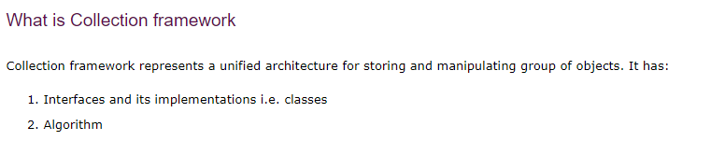
COLLECTIONS IN JAVA
Collections in java is a framework that provides an architecture to store and manipulate the group of objects.
All the operations that you perform on a data such as searching, sorting, insertion, manipulation, deletion etc. can be performed by Java Collections.

Slide 2
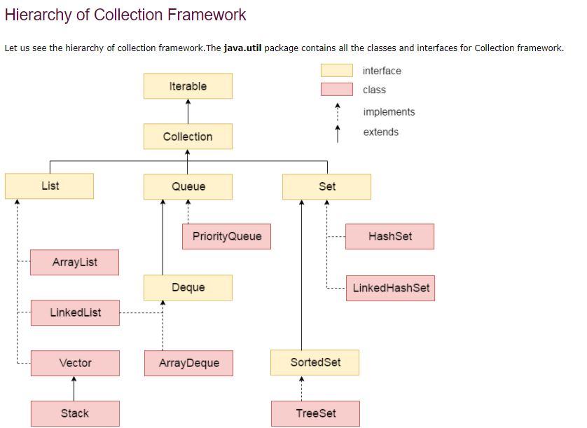
COLLECTIONS IN JAVA

Slide 3
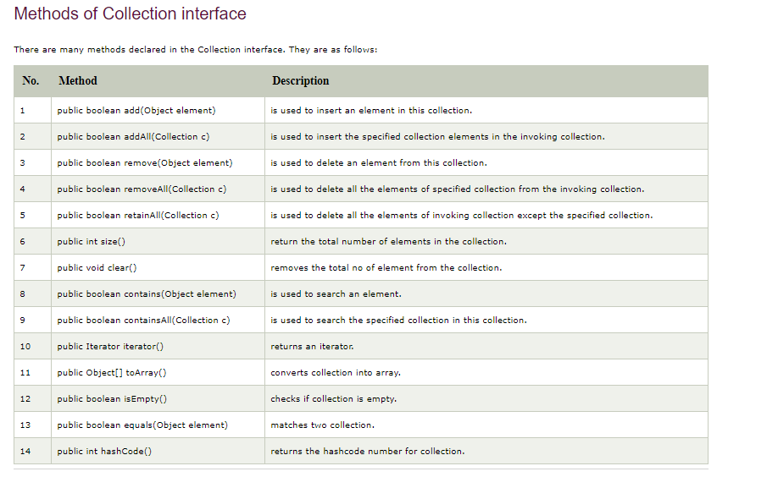
COLLECTIONS IN JAVA

Slide 4
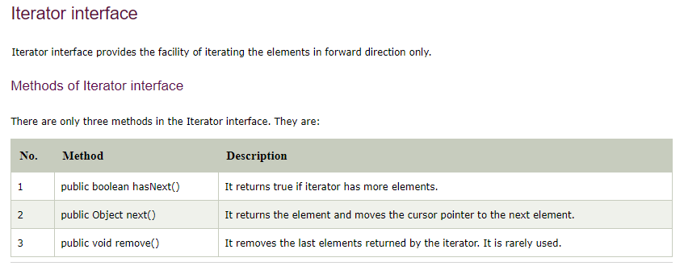
COLLECTIONS IN JAVA

Slide 5
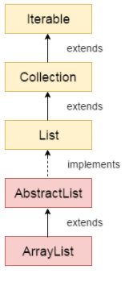
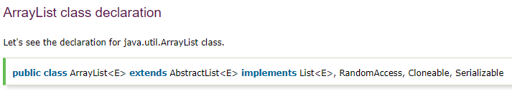
Java ArrayList class
Java ArrayList class uses a dynamic array for storing the elements. It inherits AbstractList class and implements List interface

Slide 6
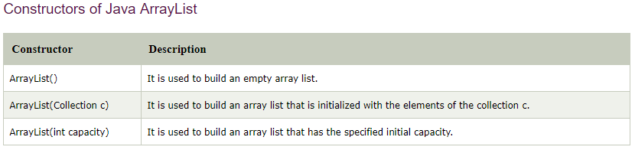
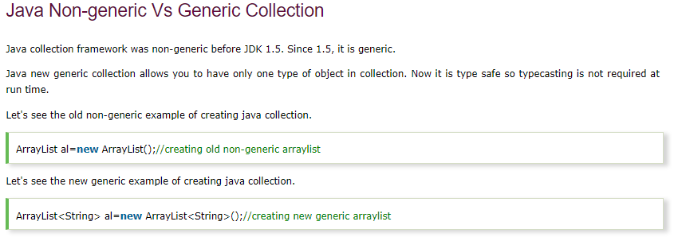
Java ArrayList class

Slide 7
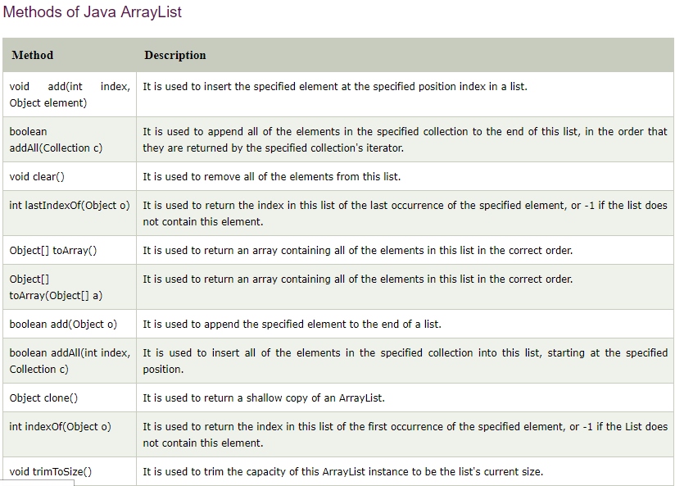
Java ArrayList class

Slide 8
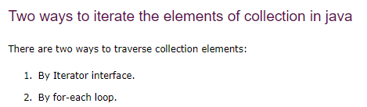
Java ArrayList class
Traversal Examples:
TestCollection1.java
TestCollection2.java

Slide 9



Java ArrayList class
Examples:
Student.java
TestCollection3.java
Examples:
TestCollection4.java
Examples:
TestCollection5.java

Slide 10
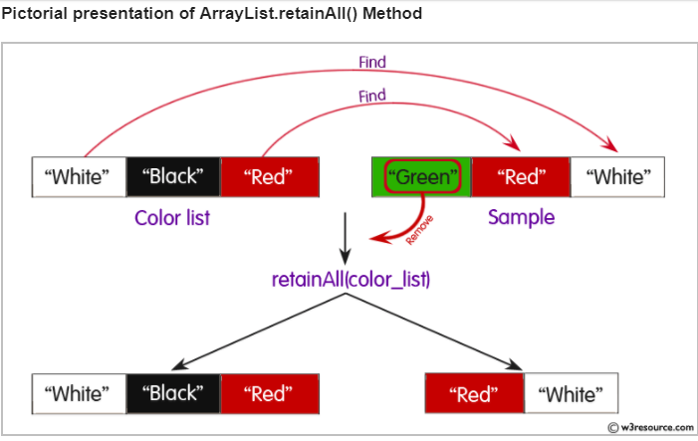
Java ArrayList class
Examples:
TestCollection6.java

Slide 11
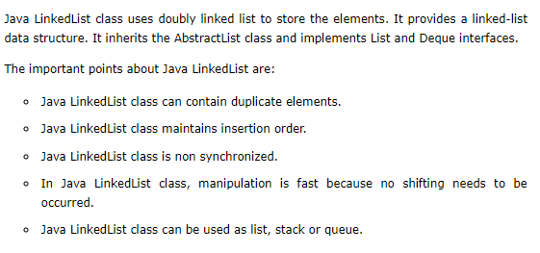
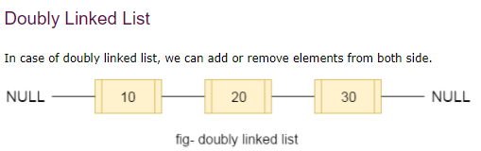
Java LinkedList class

Slide 12
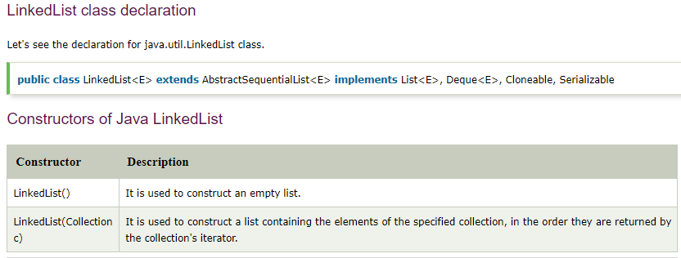
Java LinkedList class

Slide 13
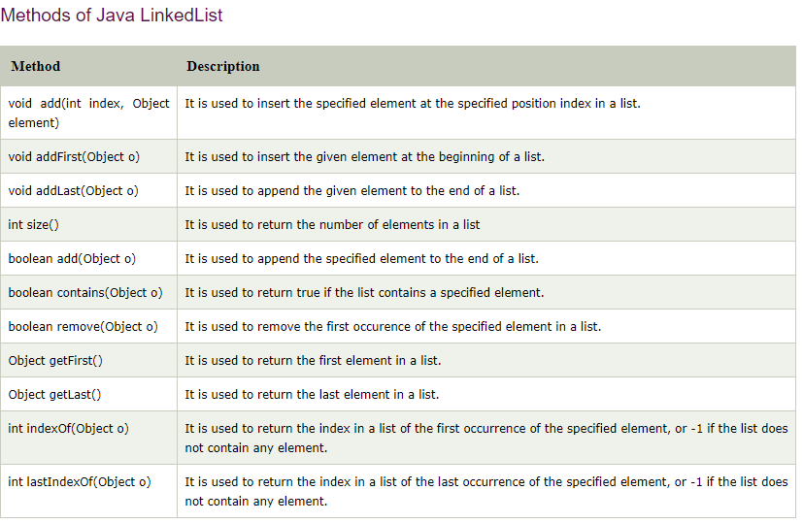
Java LinkedList class

Slide 14
Java LinkedList class
Examples:
TestCollection7.java
TestCollection8.java

Slide 15
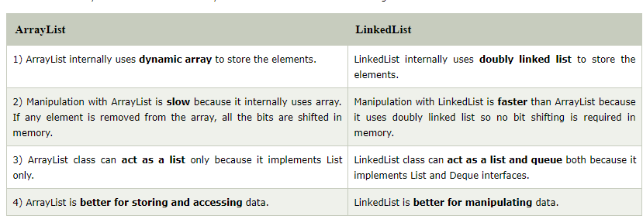
Difference between ArrayList and LinkedList
Examples:
TestArrayLinked.java

Slide 16
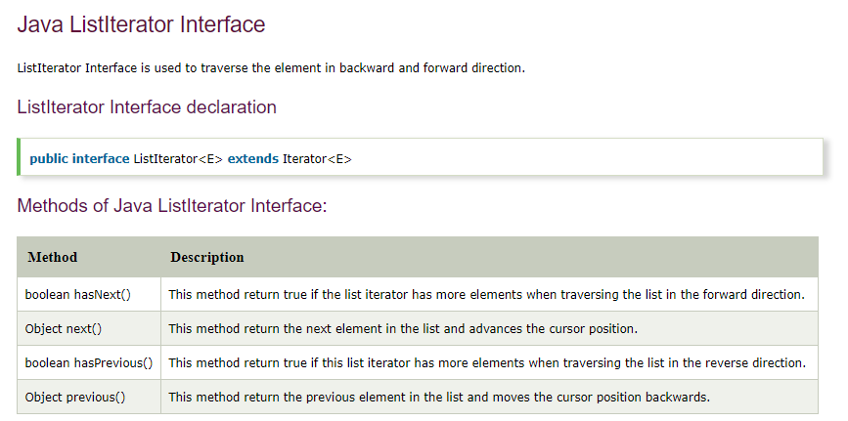
Difference between ArrayList and LinkedList
Examples:
MyListIterator.java

Slide 17
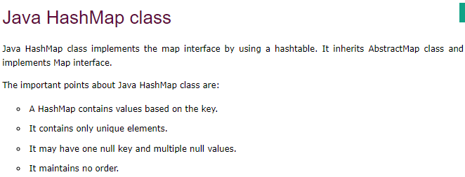
Examples:
TestCollection13.java
HashMapExample.java
https://www.javatpoint.com/collections-in-java
https://www.w3resource.com/java-tutorial/java-collections.php

